Slide 1
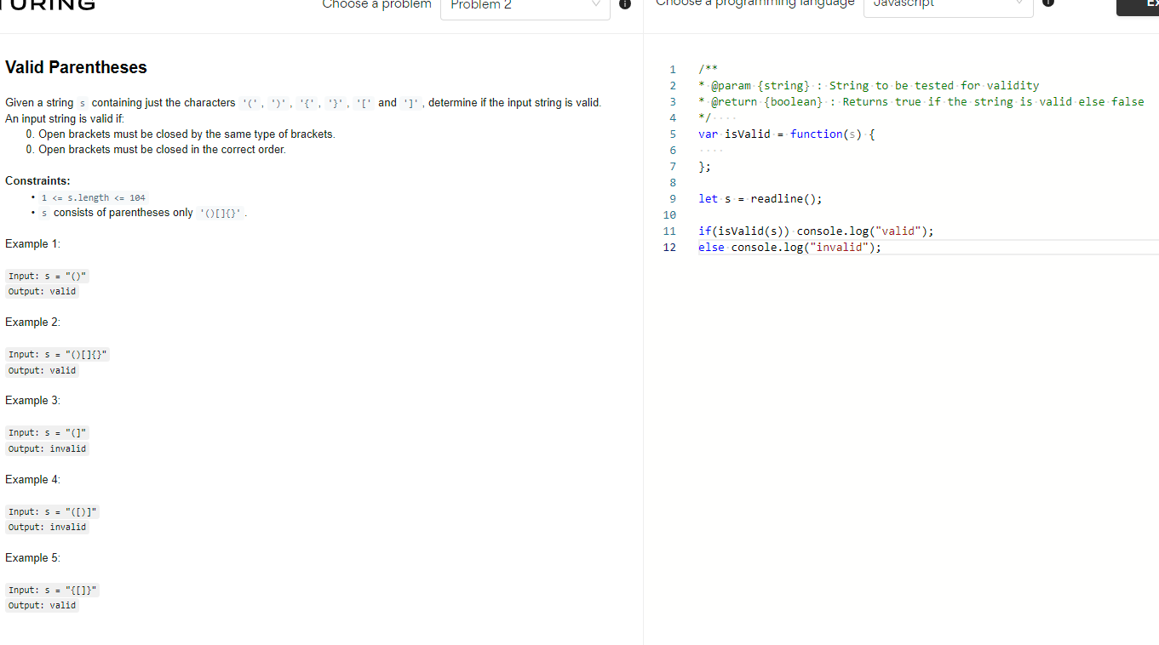
function isValid(s: string): boolean {
const bracketsMap = {
')': '(',
']': '[',
'}': '{'
}
let openBracketsStack = []
for (let i = 0; i < s.length; i++) {
const currentBracket = s[i]
if (['(', '[', '{'].includes(currentBracket)) {
openBracketsStack.push(currentBracket)
} else if (openBracketsStack.pop() !== bracketsMap[currentBracket]) {
return false
}
}
return !openBracketsStack.length
};

Slide 2
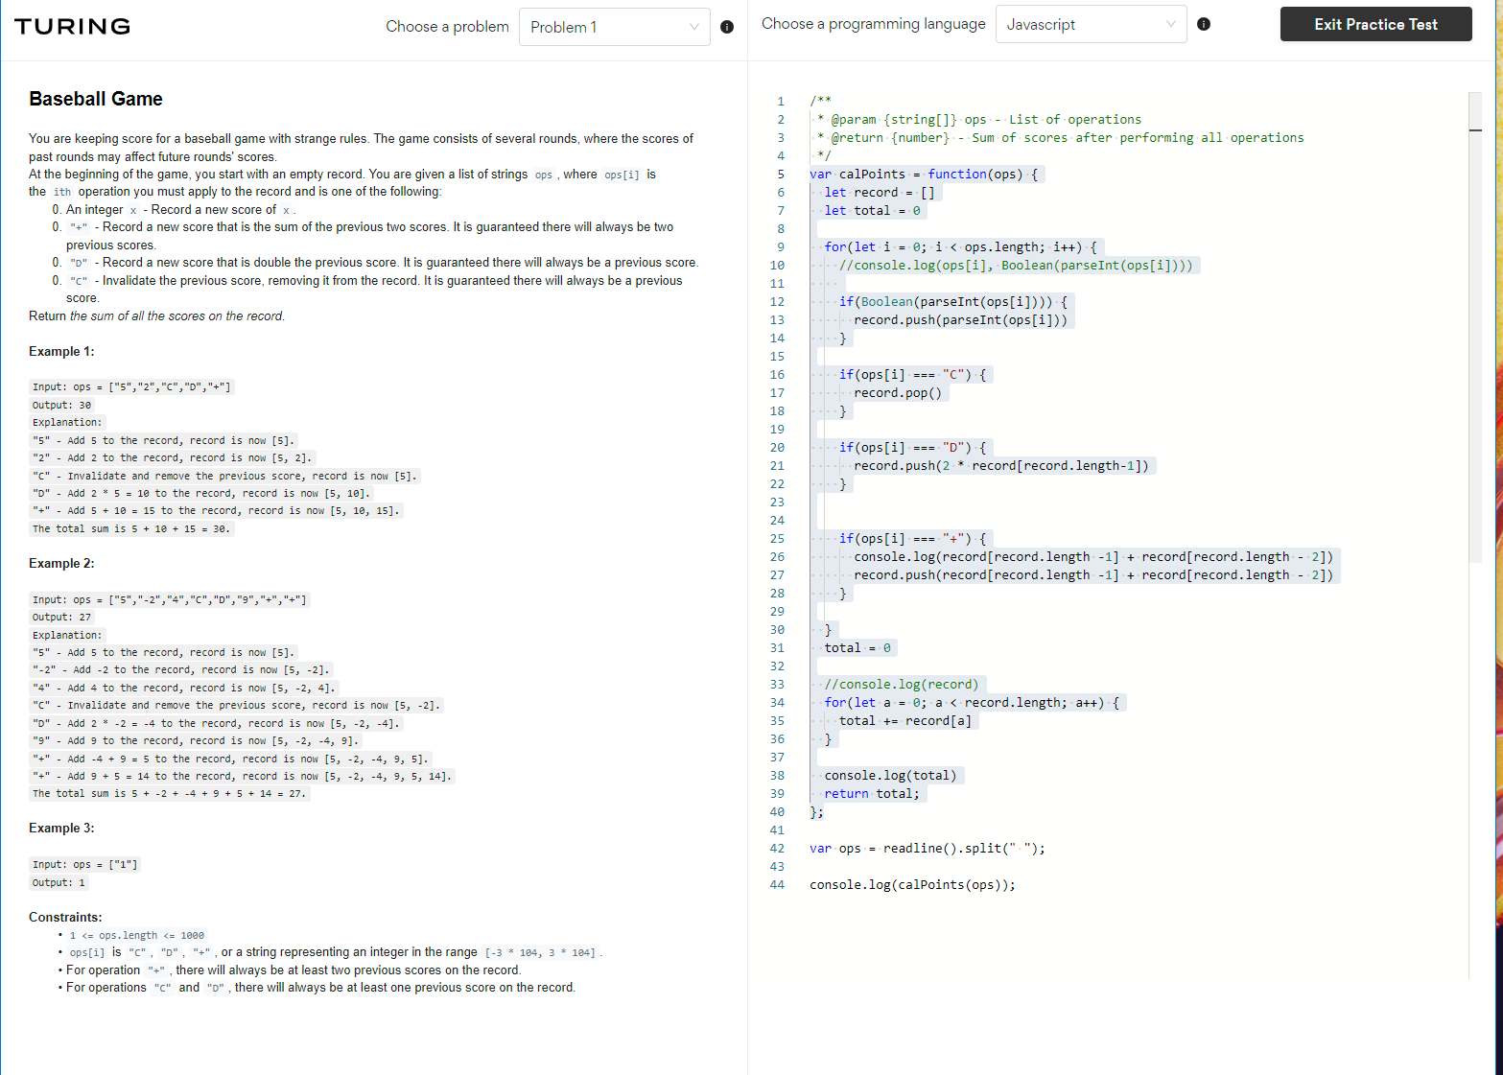

Slide 3
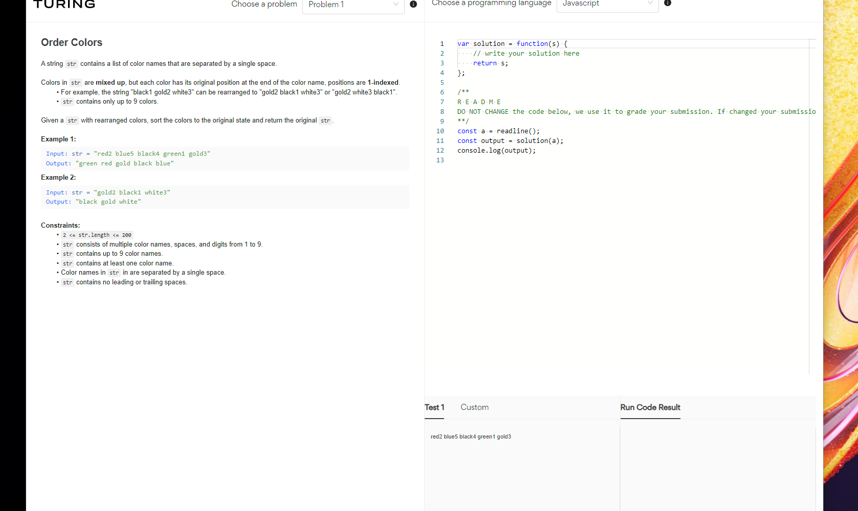

Slide 4
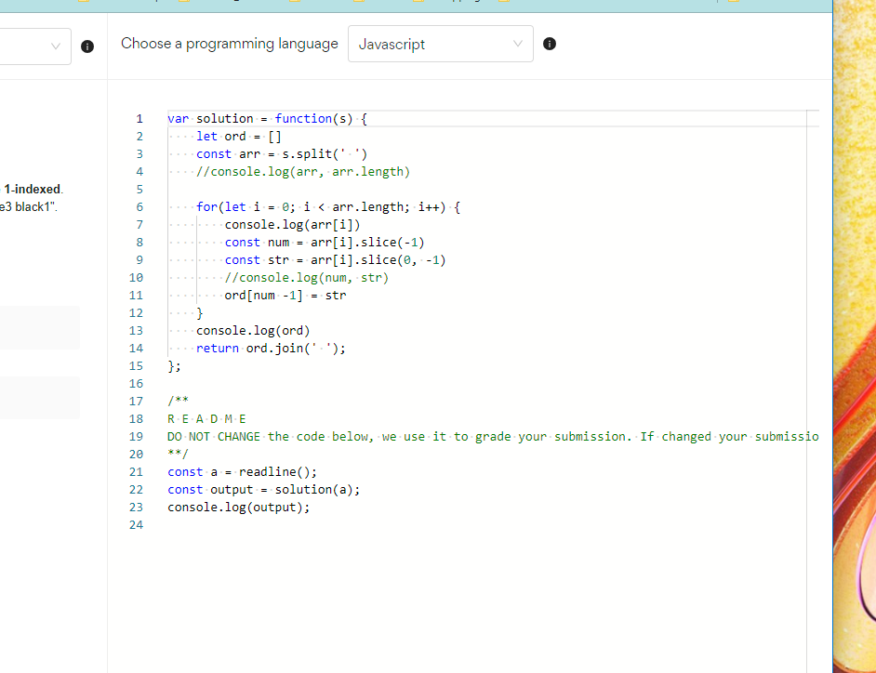

Slide 5
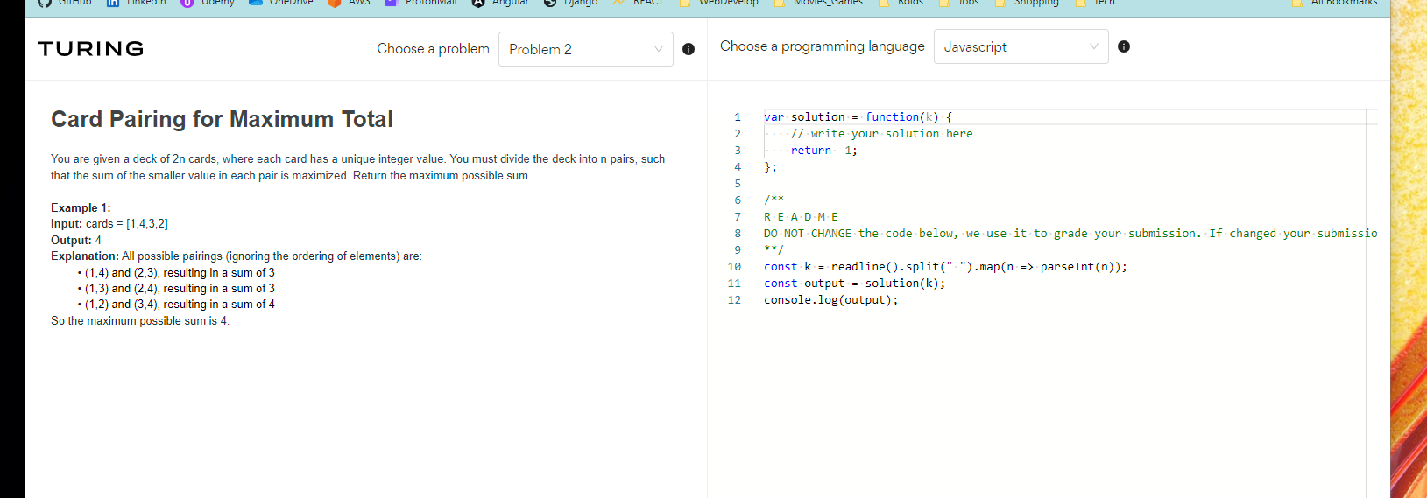

Slide 6
function maxPairs(arr: number[]): number {
let sum = 0
//let comb = []
for (let i = 0; i < arr.length / 2; i++) {
//console.log(arr[i], arr[arr.length - 1 - i])
sum += Math.min(arr[i], arr[arr.length - 1 - i])
}
//comb.push(sum)
//arr.sort((a, b) => a - b)
//console.log('---')
//sum = 0
//for (let i = 0; i < arr.length; i += 2) {
//sum += Math.min(arr[i], arr[i + 1])
//}
return sum
}
console.log(maxPairs([1, 4, 3, 2]))

Slide 7
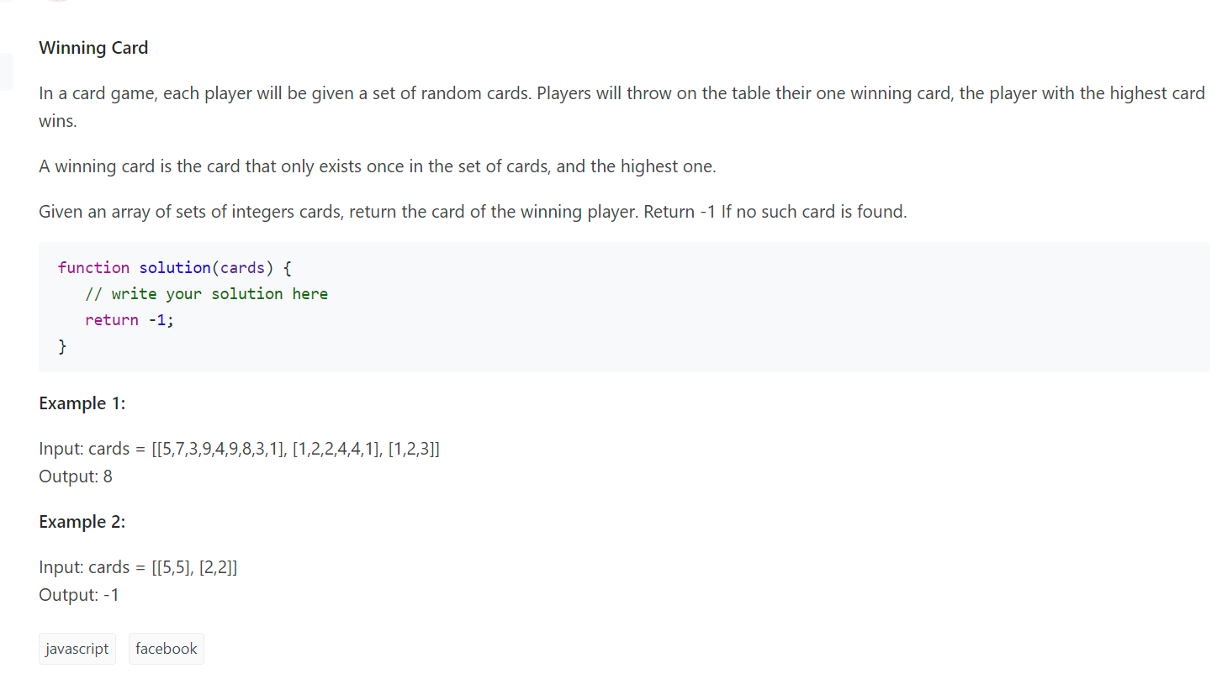

Slide 9
function solution(cards) {
let winner=-1
cards.forEach(function(card){
let NoDuplicate= (card.filter((el, _, card) => {
return card.filter(el2 => el2 === el).length === 1
}))
let highCard=Math.max(...NoDuplicate)
if(winner<highCard){
winner=highCard;
}
})
return winner;
}
console.log(solution([[5,7,3,9,4,9,8,3,1],[1,2,2,4,4,1],[1,2,3]]))
console.log(solution( [[5,5], [2,2]]))

Slide 10
1672. Richest Customer Wealth
function maximumWealth(accounts: number[][]): number {
let sum:number
let newArray:number[] = []
for(let i = 0 ; i < accounts.length ; i ++){
sum = 0
for(let j = 0; j < accounts[i].length; j++){
sum += accounts[i][j]
newArray.push(sum)
}
}
let result = newArray.sort((a,b)=>b-a)
return result[0]
};

